Slide 1

万盛工商局大数据平台方案

Slide 2

01
功能需求列表
01
02
系统结构
10
目录
03
数据同步方案
15
04
问题与风险
20

Slide 3
万盛工商局大数据平台方案
第一部分
第二部分
第三部分
第四部分

Slide 4
功能需求列表
01
实体查询、统计、分析
02
征信查询、统计、分析
03
执法队情报查询、统计、分析
04
电商监管
05
远程会议
06
电视广告监管
07
LED大屏展示系统
08
中控室监控系统

Slide 5
功能需求列表
01
实体查询、统计、分析
基于实体信息的各种维度、法人、创建时间、区域等信息形成多维度的查询分析报表。
投诉举报（受理数量、正常办结、挽回经济损失）
行政处罚（工商案件、食药案件、质监案件、物价案件）

Slide 6
功能需求列表
02
征信查询、统计、分析
a) 从征信系统里查询指定实体的相关征信信息。
b) 在工商系统里添加与实体相关业务时，先从征信查询系统里获取实体征信情况，弹出征信信息。

Slide 7
功能需求列表
03
执法报情报查询、统计、分析
123

Slide 8
功能需求列表
04
电商监管
从网络上获取区辖区内所有注册的、以及非注册的企业实体的非法信息。
通过网络抓取，分析所管辖实体是否有负面信息。

Slide 9
功能需求列表
添加您的标题
05
远程会议
提供远程视频会议功能，供辖区内所有分局之间实现IP会议
提供多人（十人下）同时视频会议功能。

Slide 10
功能需求列表
06
电视广告监管
识别电视广告里的符合设定条件的指定关键字

Slide 11
功能需求列表
07
LED大屏展示系统
门外约 2.5* 1.5 LED 展示屏，用于视频宣传

Slide 12
功能需求列表
08
中控室监控系统
通过中控室，可以监看所有分局、景点的摄像头。对所管辖区域的分组，以及对摄像头分组。中控室约4米*3米墙体大屏幕查看。

Slide 13
系统结构
工商局大数据平台
实体系统
LED大屏展示
中控室监控系统
征信系统
执法队情报
电商监管
电视广告监管
远程会议
工商系统

Slide 14
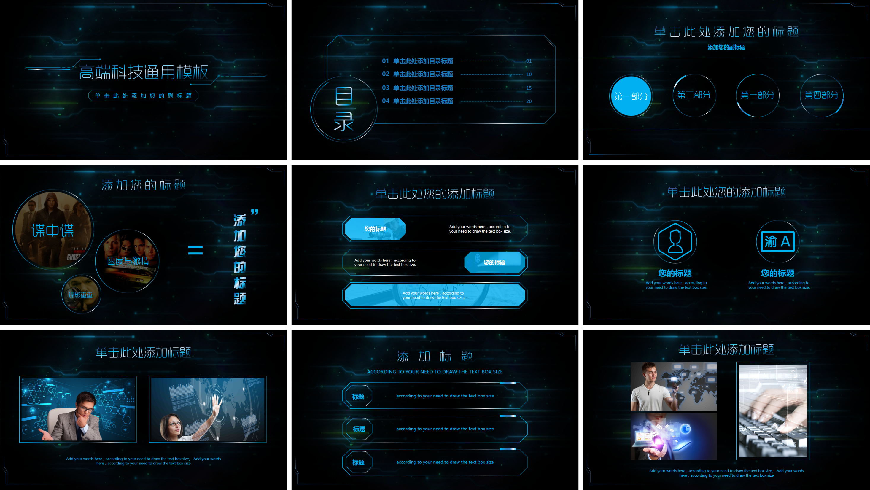

Slide 15
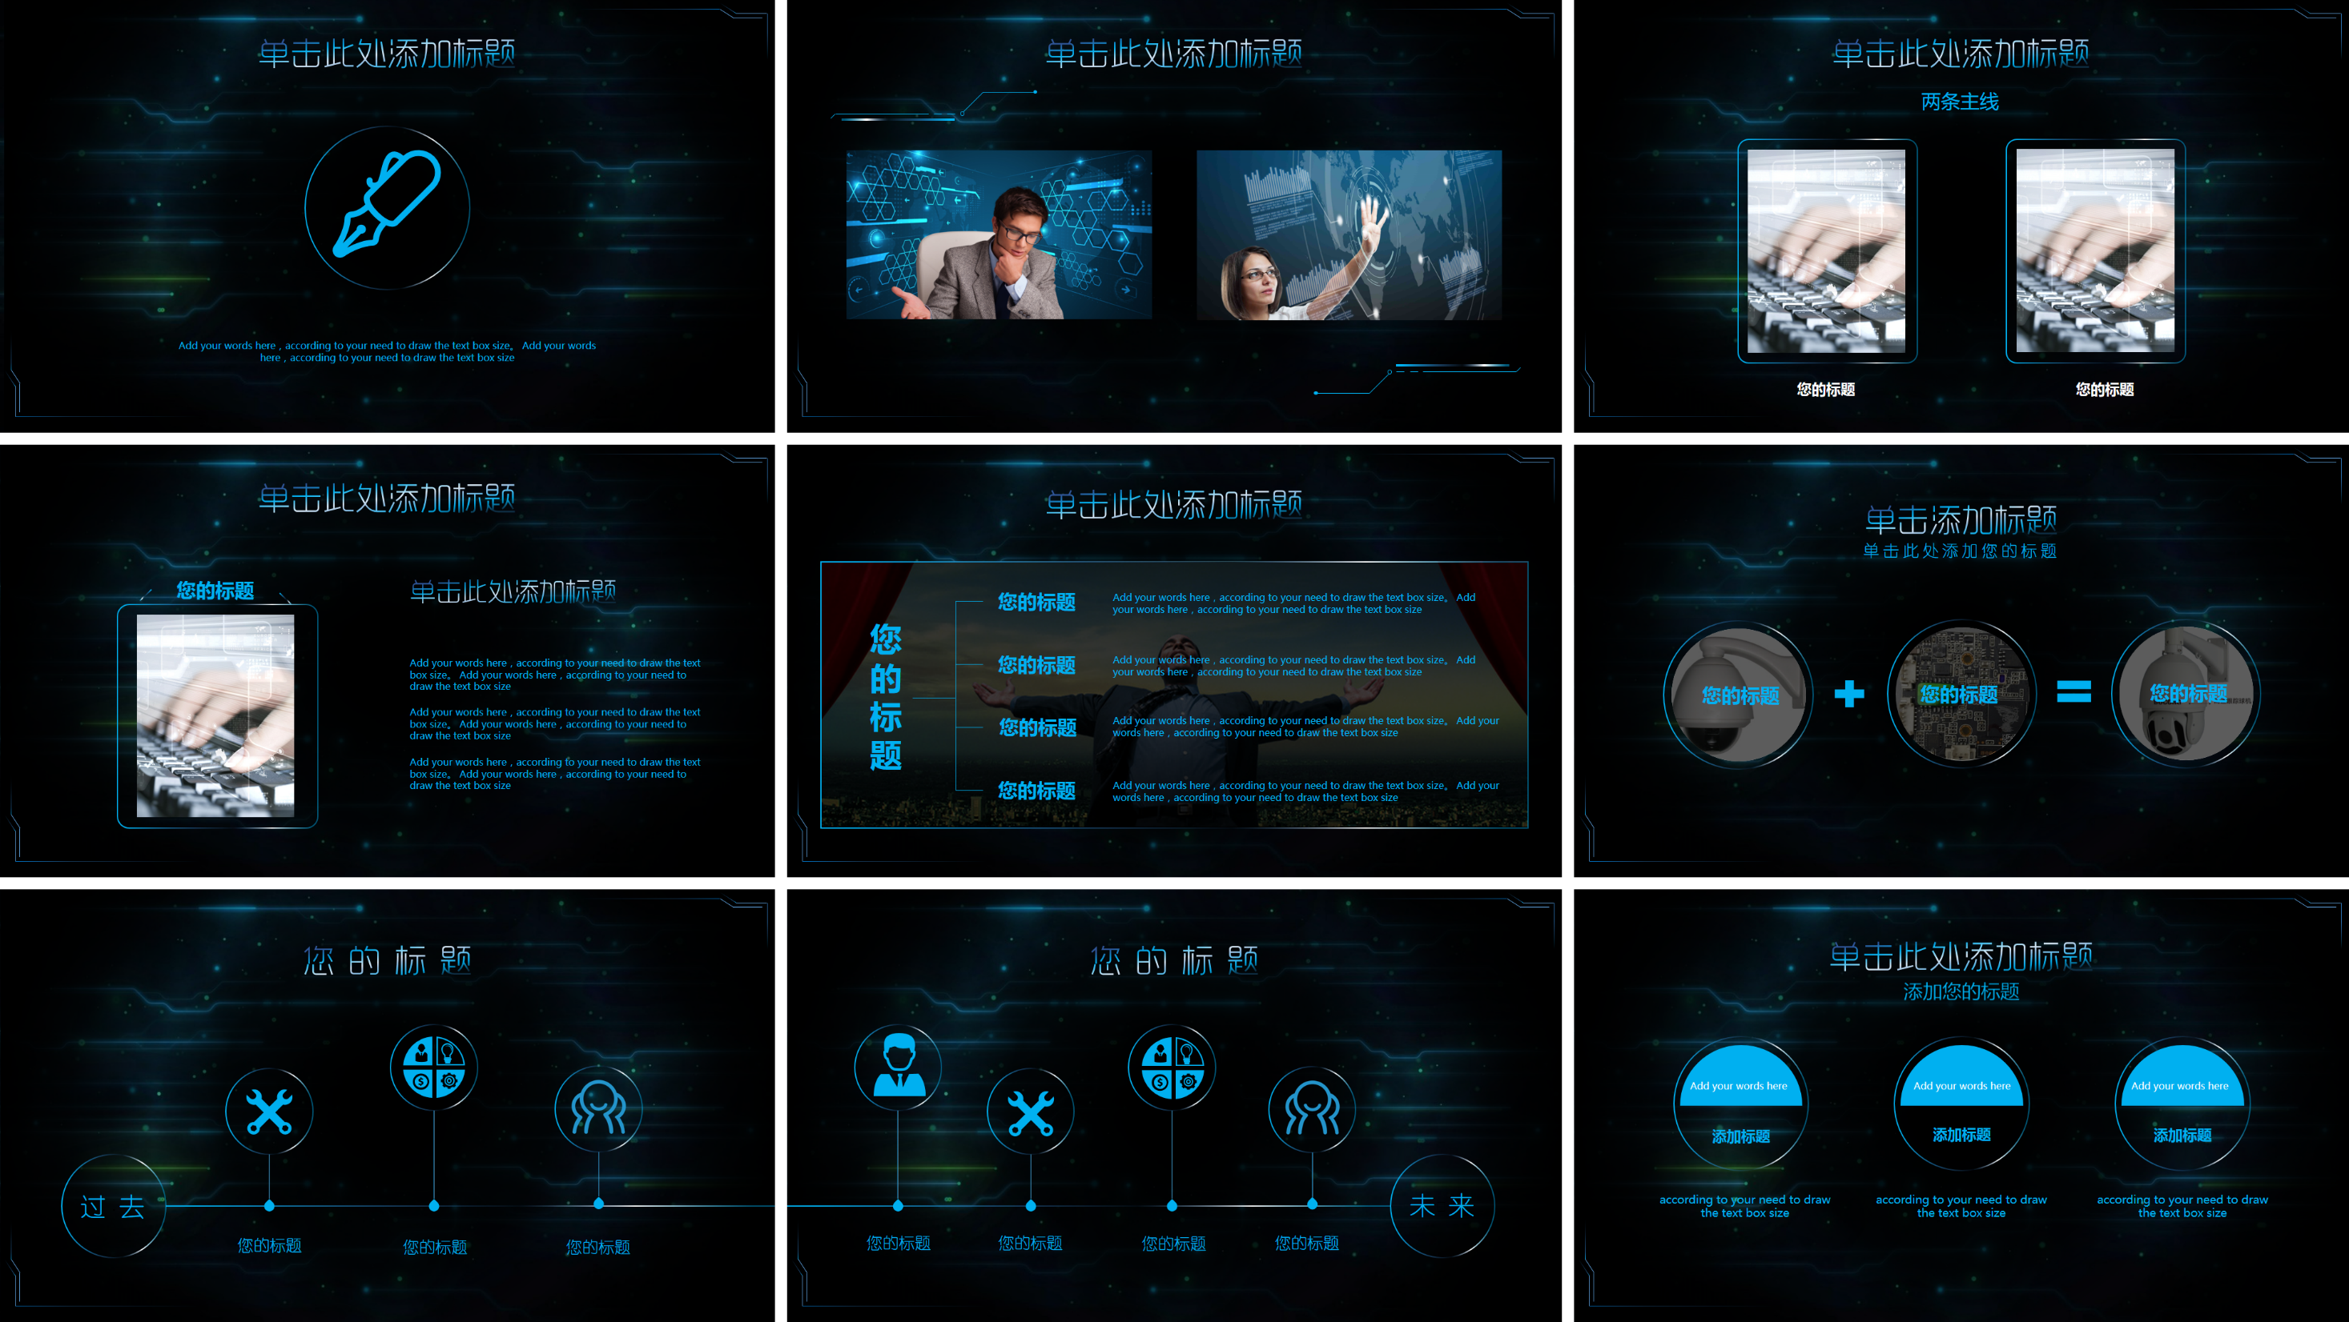

Slide 16


Slide 17



添加您的标题
”
添加您的标题
谍中谍
＝
速度与激情
谍影重重

Slide 18



单击此处您的添加标题
您的标题
Add your words here，according to your need to draw the text box size。
Add your words here，according to your need to draw the text box size。
您的标题
Add your words here，according to your need to draw the text box size。

Slide 19
单击此处您的添加标题
您的标题
您的标题
Add your words here，according to your need to draw the text box size。
Add your words here，according to your need to draw the text box size。

Slide 20


单击此处添加标题
Add your words here，according to your need to draw the text box size。 Add your words here，according to your need to draw the text box size

Slide 21
添加标题
ACCORDING TO YOUR NEED TO DRAW THE TEXT BOX SIZE
标题
according to your need to draw the text box size
标题
according to your need to draw the text box size
标题
according to your need to draw the text box size

Slide 22



单击此处添加标题
Add your words here，according to your need to draw the text box size。 Add your words here，according to your need to draw the text box size

Slide 23
单击此处添加标题
Add your words here，according to your need to draw the text box size。 Add your words here，according to your need to draw the text box size

Slide 24
单击此处添加标题

Slide 25
单击此处添加标题
两条主线
您的标题
您的标题

Slide 26
单击此处添加标题
您的标题
单击此处添加标题
Add your words here，according to your need to draw the text box size。 Add your words here，according to your need to draw the text box size
Add your words here，according to your need to draw the text box size。 Add your words here，according to your need to draw the text box size
Add your words here，according to your need to draw the text box size。 Add your words here，according to your need to draw the text box size

Slide 27

单击此处添加标题
您的标题
Add your words here，according to your need to draw the text box size。 Add your words here，according to your need to draw the text box size
您的标题
您的标题
Add your words here，according to your need to draw the text box size。 Add your words here，according to your need to draw the text box size
您的标题
Add your words here，according to your need to draw the text box size。 Add your words here，according to your need to draw the text box size
您的标题
Add your words here，according to your need to draw the text box size。 Add your words here，according to your need to draw the text box size

Slide 28
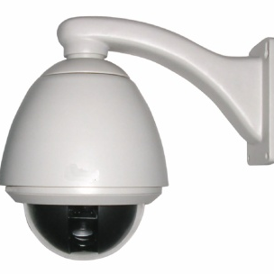
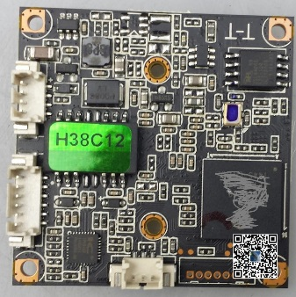
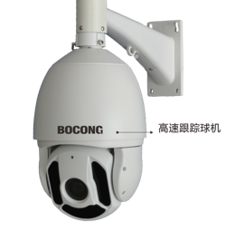
单击添加标题
单击此处添加您的标题
您的标题
您的标题
您的标题

Slide 29

您的标题
A
.
过 去
您的标题
您的标题
您的标题

Slide 30
您的标题

➔



未 来
您的标题
您的标题
您的标题
您的标题

Slide 31
单击此处添加标题
添加您的标题
Add your words here
Add your words here
Add your words here
添加标题
添加标题
添加标题
according to your need to draw the text box size
according to your need to draw the text box size
according to your need to draw the text box size

Slide 32

ADD TITLE
Add your words here，according to your need to draw the text box size。Please read the instructions and more work at the end of the manual template.
ADD TITLE
Add your words here，according to your need to draw the text box size。
Add your words here，according to your need to draw the text box size。
Add your words here，according to your need to draw the text box size。

Slide 33



添加标题
according to your need to draw the text box size
according to your need to draw the text box size
according to your need to draw the text box size

Slide 34
单击此处添加标题
Add your words here，according to your need to draw the text box size。 Add your words here，according to your need to draw the text box size

Slide 35
添加标题
ADD TITLE
according to your need to draw the text box size
ADD TITLE
according to your need to draw the text box size
ADD TITLE
ADD TITLE
according to your need to draw the text box size
ADD TITLE
according to your need to draw the text box size

Slide 36
5
5
4
4
ADD TITLE
3
ADD TITLE
according to your need to draw the text box size
ADD TITLE
ADD TITLE
according to your need to draw the text box size
according to your need to draw the text box size
ADD TITLE
according to your need to draw the text box size
according to your need to draw the text box size

Slide 37

ADD TITLE
add your words here
according to your need to draw the text box size。Please read the instructions and more work at the end of the manual template.
KEYS

Slide 38
ADD TITLE
according to your need to draw the text box size。Please read the instructions and more work at the end of the manual template.
ADD TITLE
according to your need to draw the text box size。Please read the instructions and more work at the end of the manual template.

Slide 39
感谢您的欣赏
单击此处添加您的副标题

